Slide 1







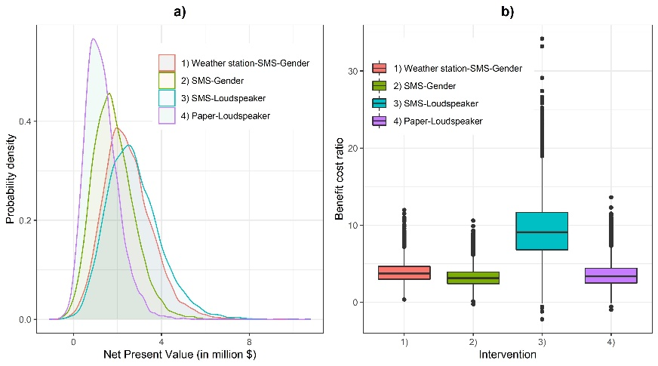


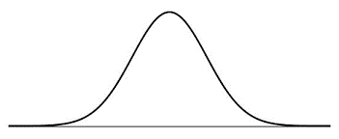
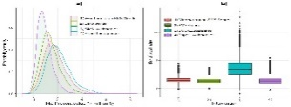
Decision analysis of agro-climate service scaling
Net present value
Risk
Benefit
Discount rate
Cost
Generate
Translate
Transfer
Use
Criteria
Investment decision
Identify experts
Characterize interventions
1
2
3
Conceptual framework
Refine model
4
Mathematical model
Simulate and analyze data
Share results
5
6
7

